Slide 1



聊天室
Linux
Author: HP
Notes:
https://pixabay.com_zh_银河-nightsky-星星-夜-星云-349720_
https://pixabay.com_zh_北极光-时间间隔-极光-太阳风-光-绿色-明星追踪-星轨道-225525_
https://pixabay.com_zh_水下-蓝色-海洋-海-跳水-旱厕-自然-深-绿松石-水-802092_
https://pixabay.comzh男子-阅读-触摸屏-博客-数字-片剂-工作-娱乐休闲-屏幕-791049

Slide 2
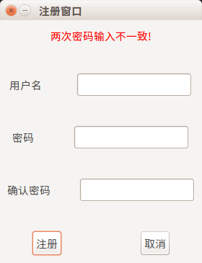
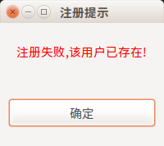
聊天室注册界面

Slide 3
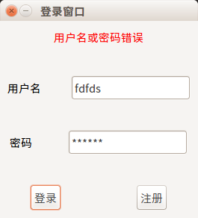
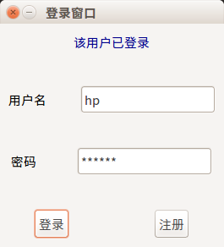
聊天室登录界面

Slide 4

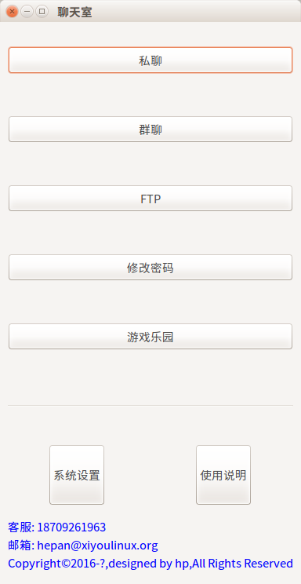
聊天室主界面

Slide 5

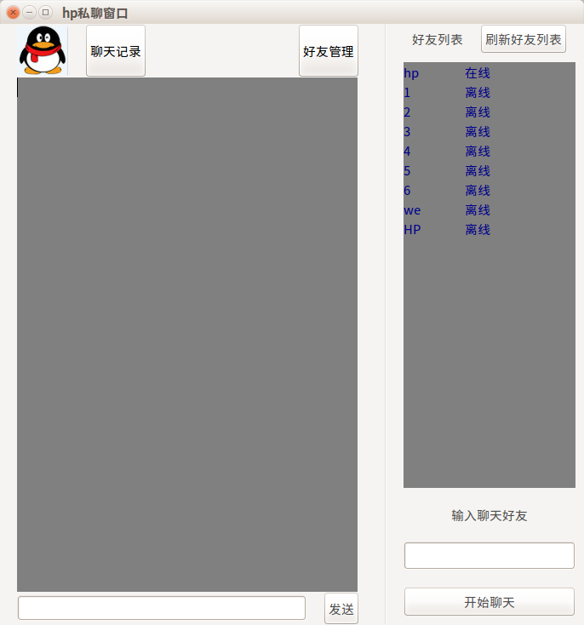
私聊

Slide 6
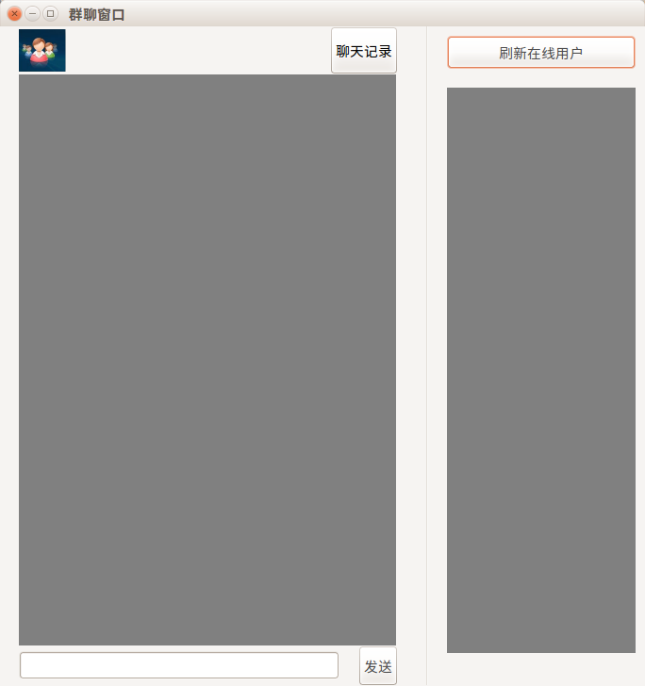
群聊

Slide 7
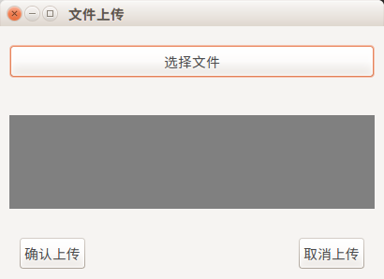
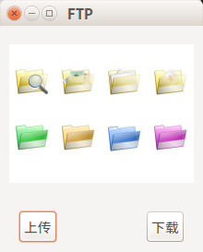
FTP

Slide 8

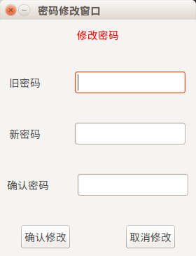
修改密码

Slide 9


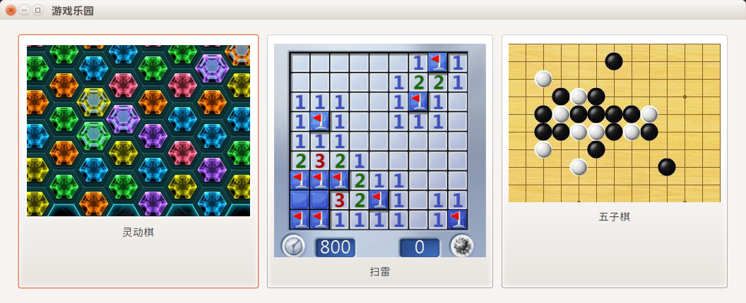
游戏乐园

Slide 10
Business Template
Four short words sum up what has lifted most successful individuals above the crowd a little bit more.
酷炫

Slide 11
That's all,thank you

